Slide 2
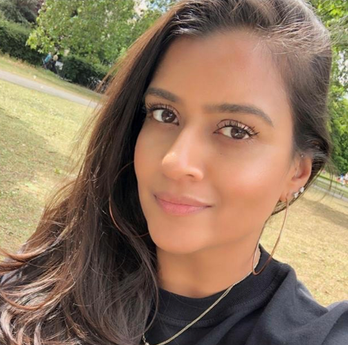

About Nisha
Hometown: London
Took a “Proper British Brew” tea making class
Obsessed with Kitchen Gadgets
nishaparkash

Slide 3
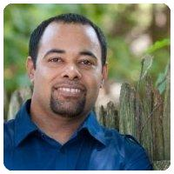

About Michael
Hometown: Mount Holly, NJ
Can order from Burger King in Dutch (Nederland)
#BlackLivesMatter
michaelswinslow

Slide 4
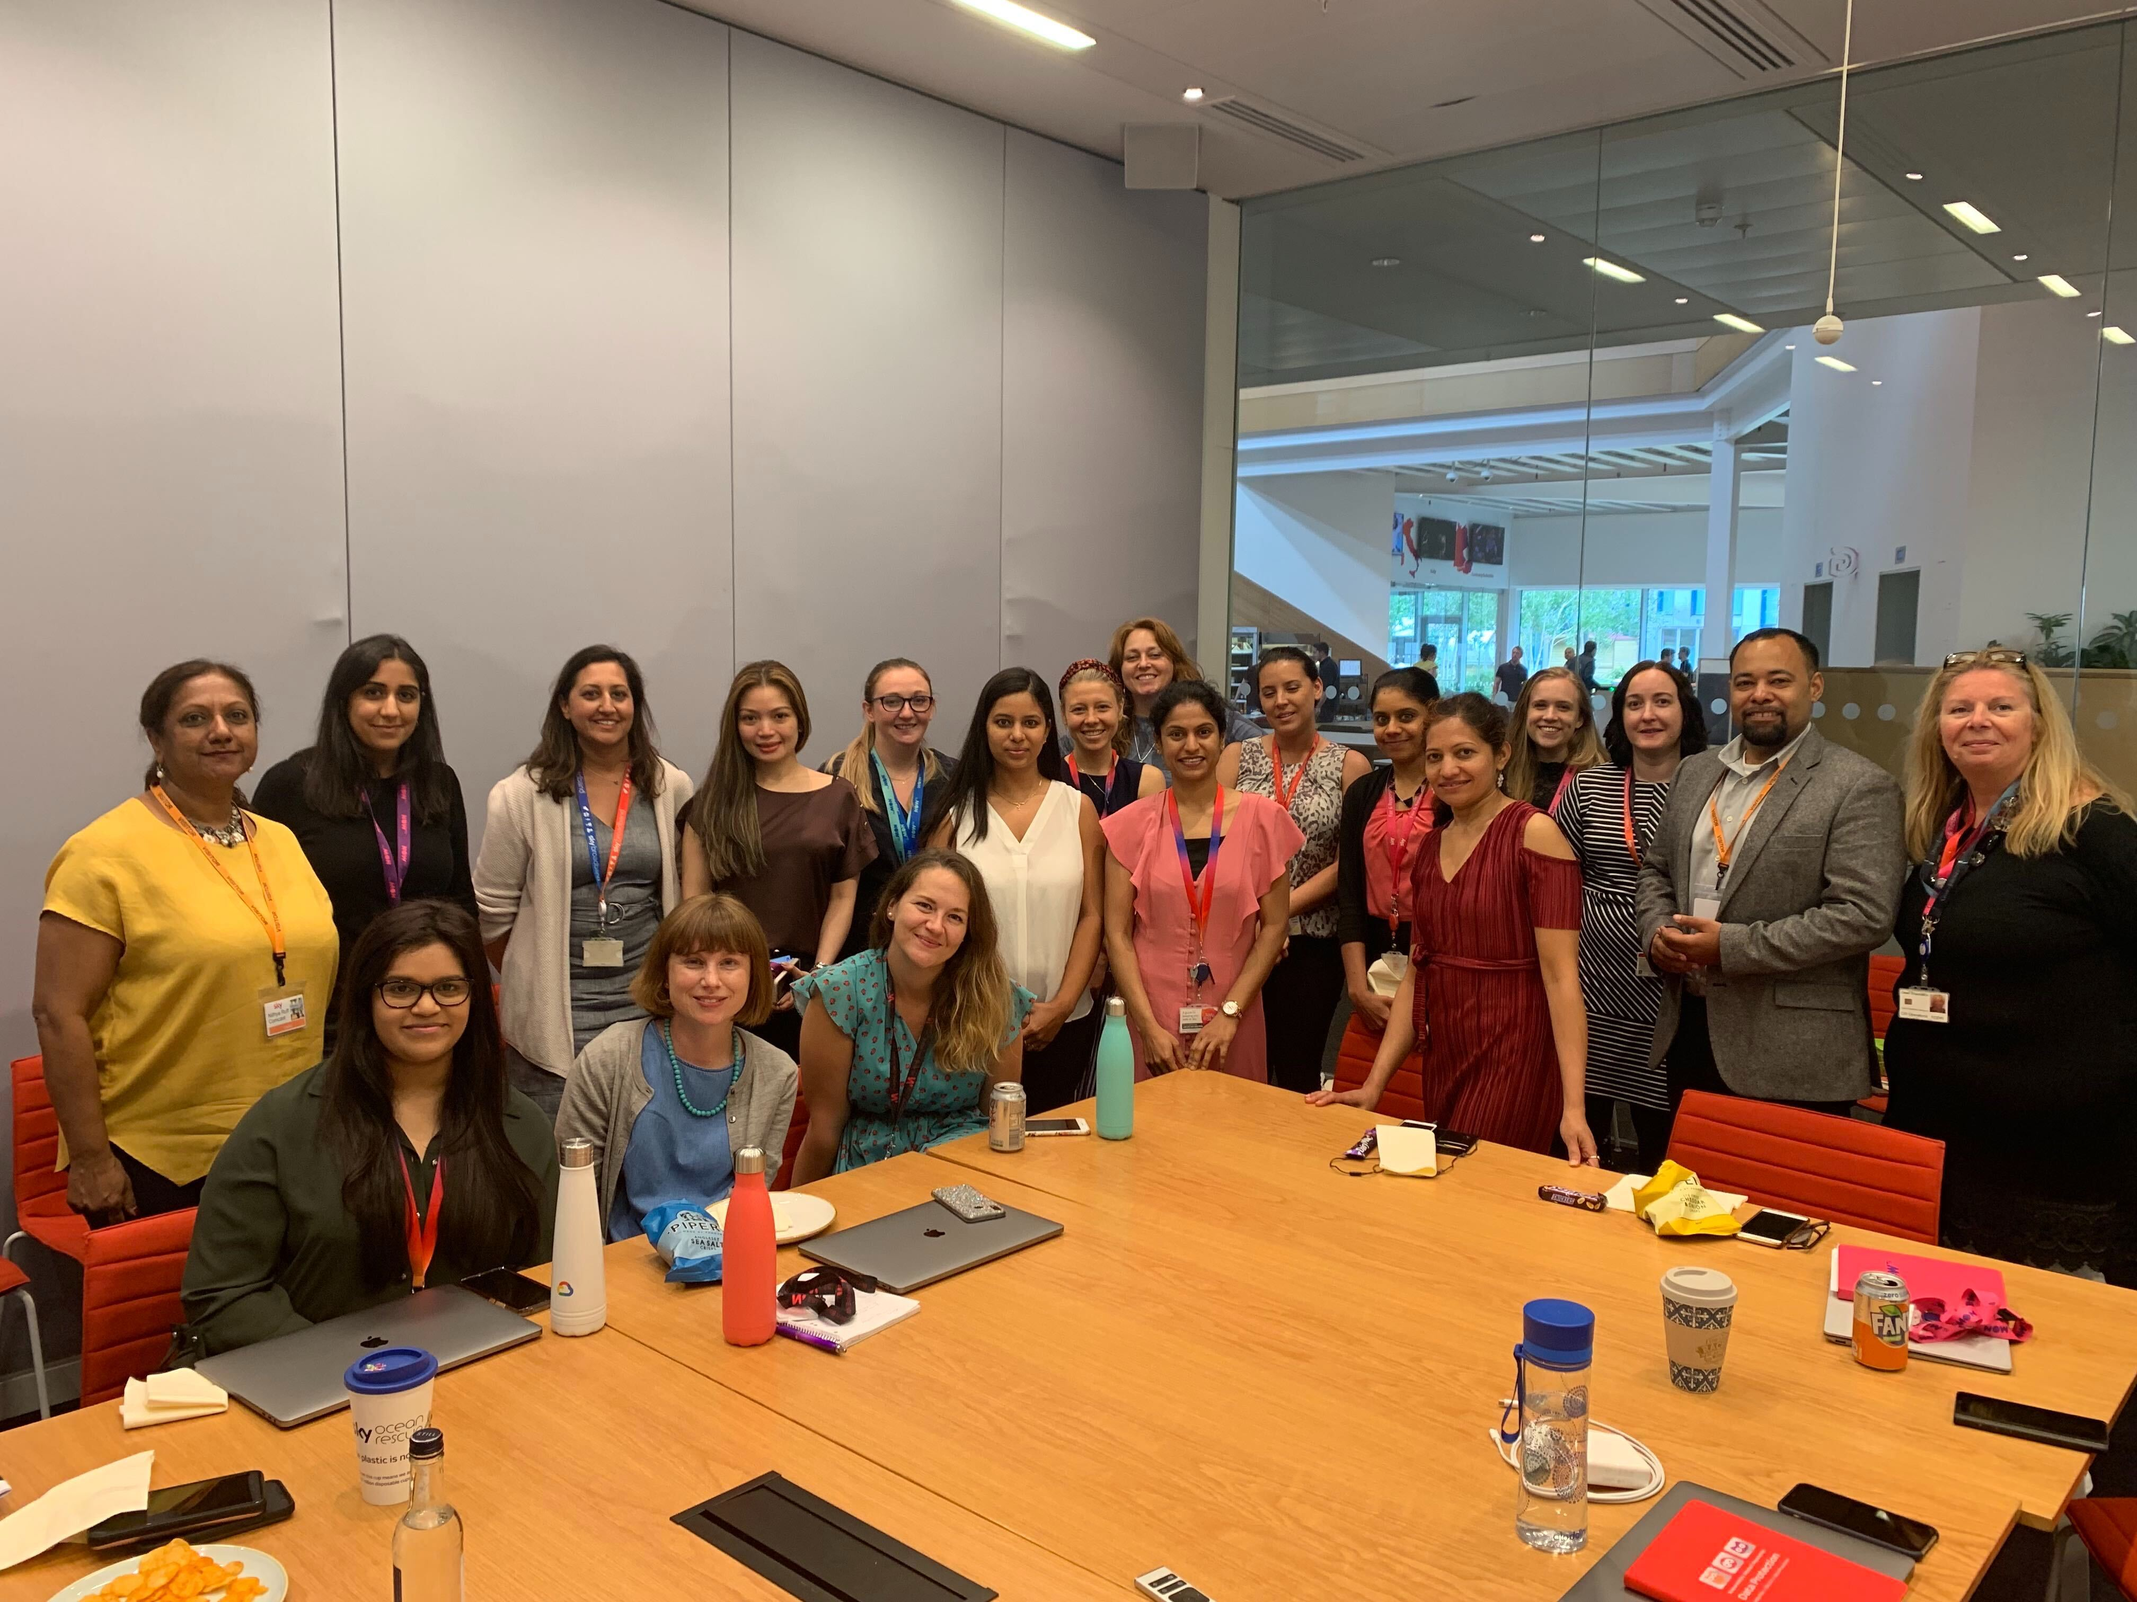
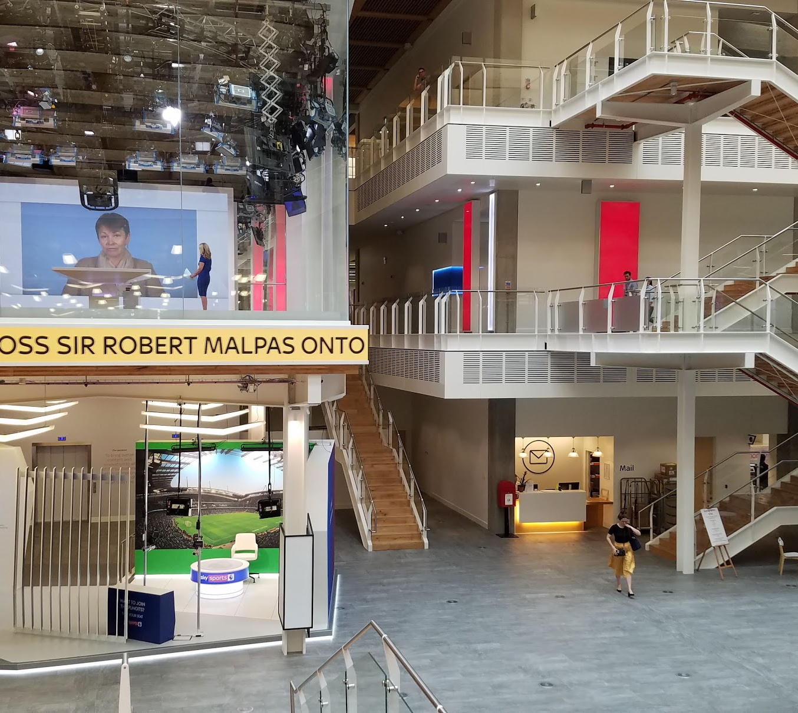
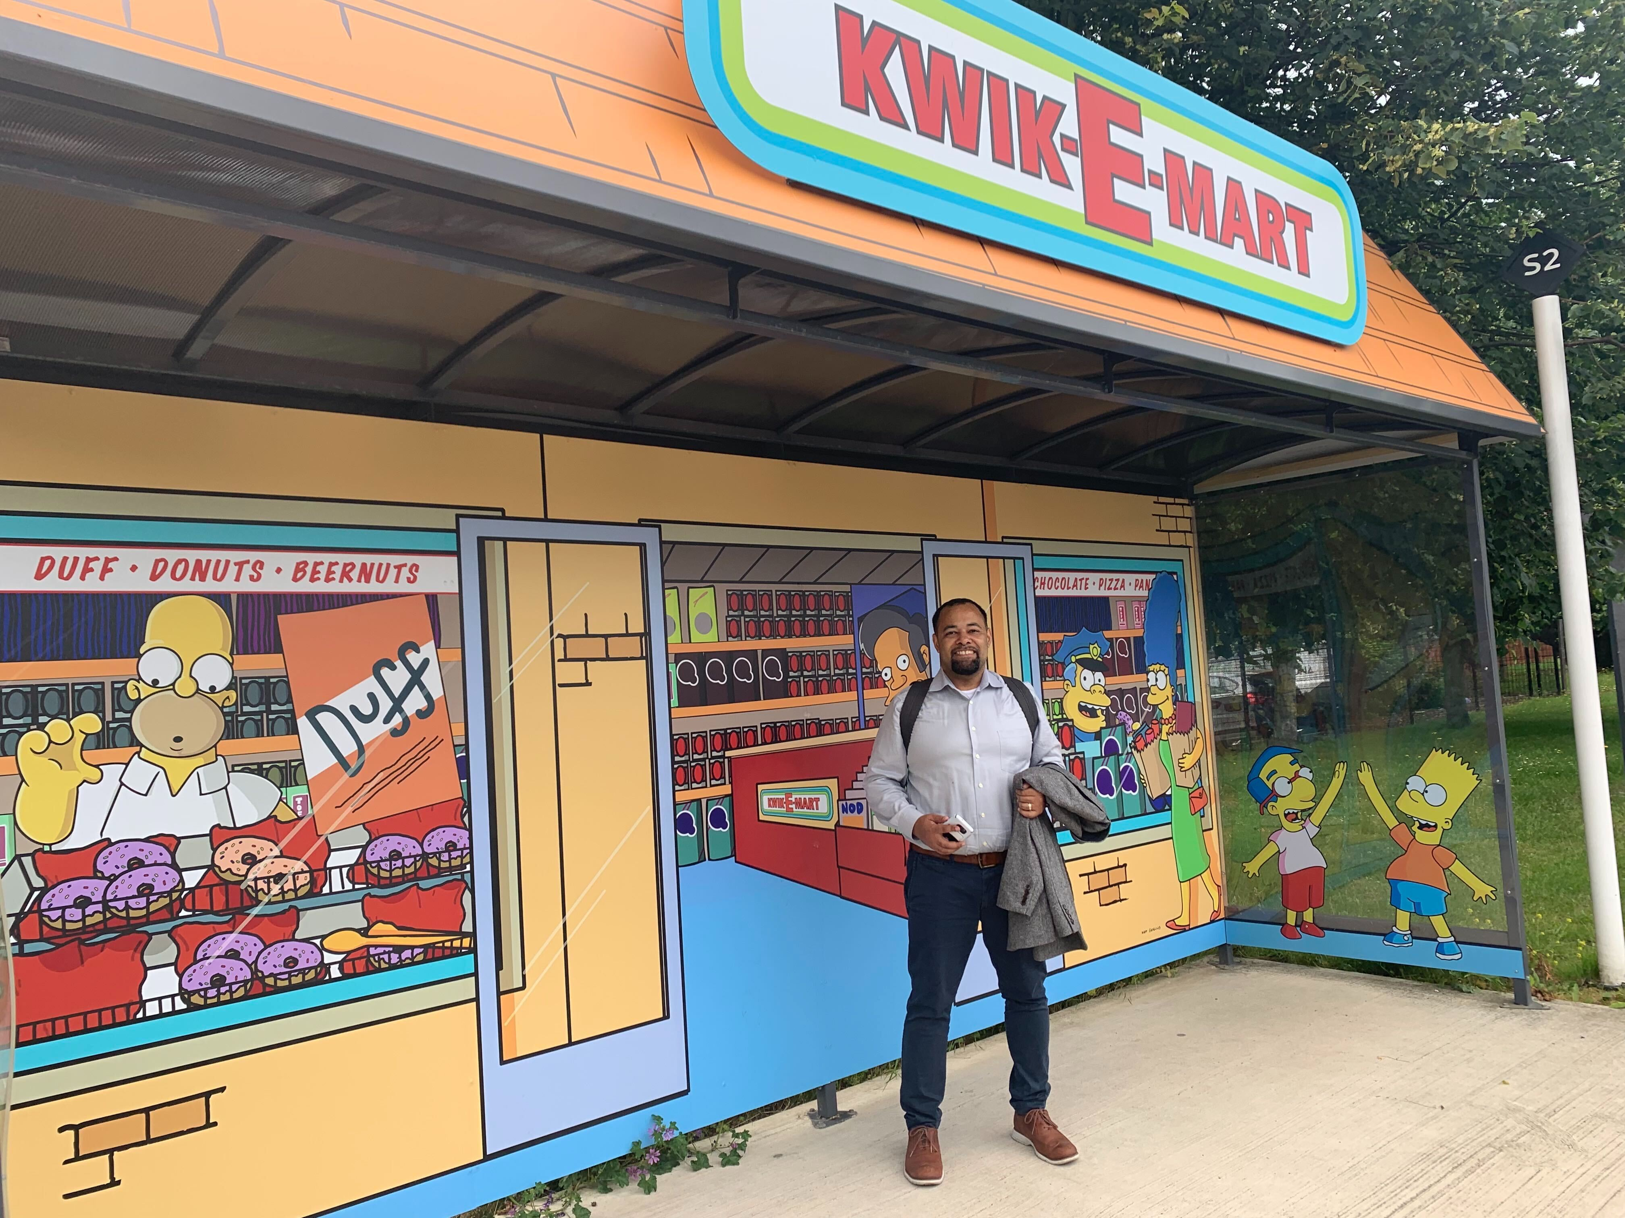
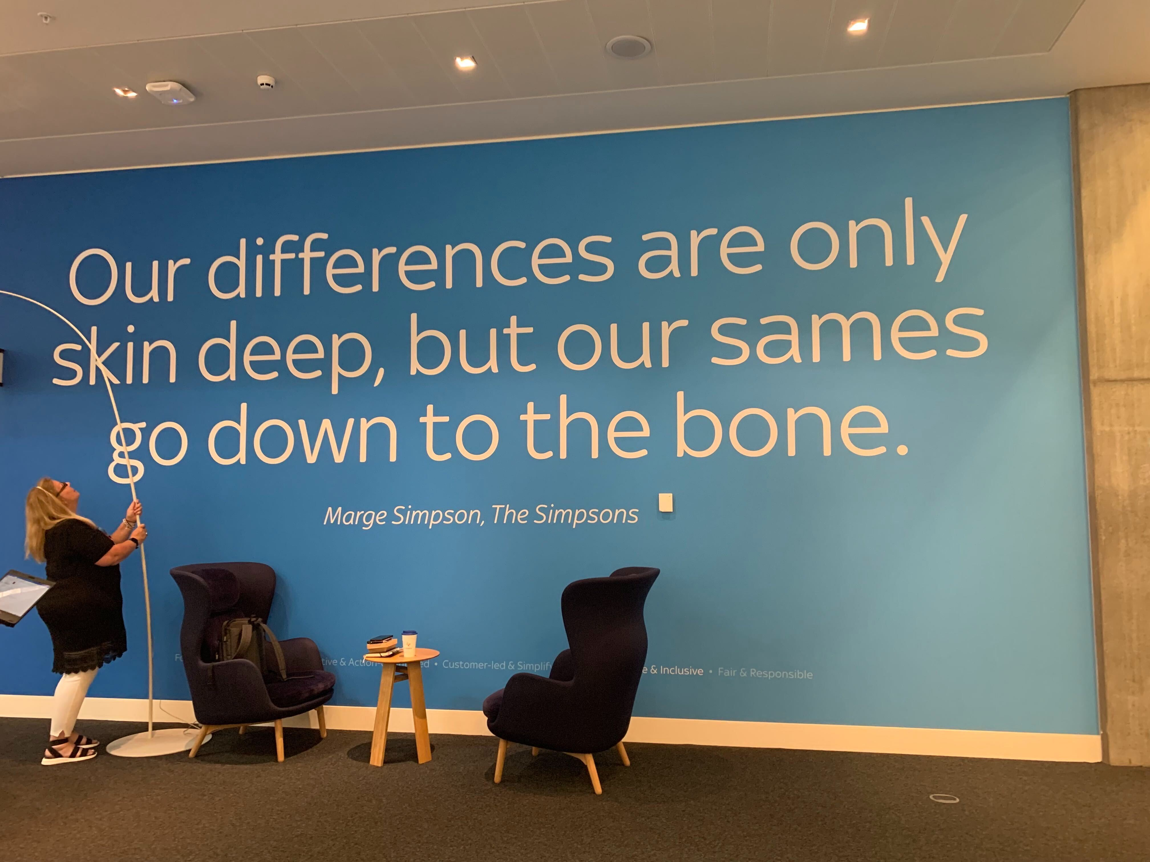
June 2019
@michaelswinslow

Slide 5
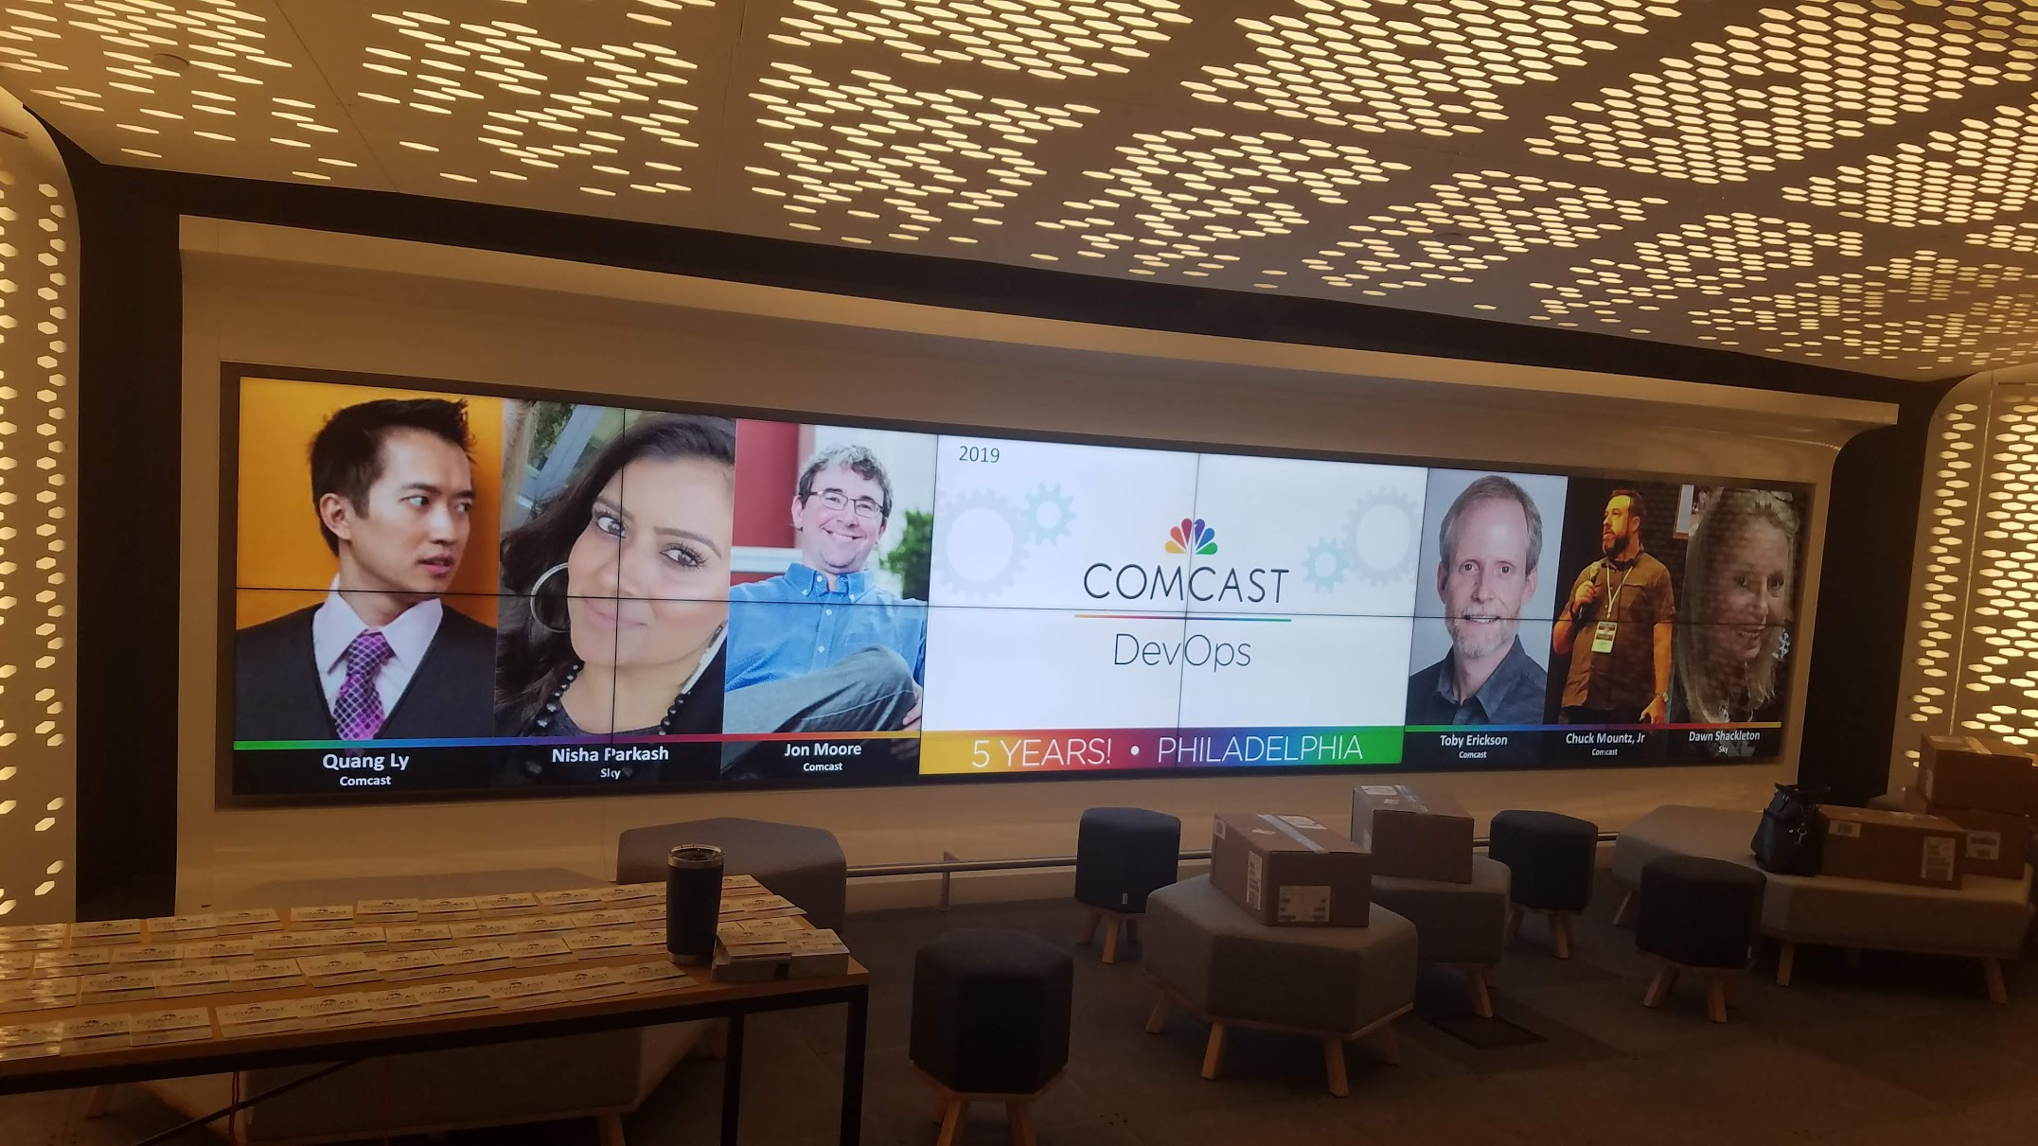
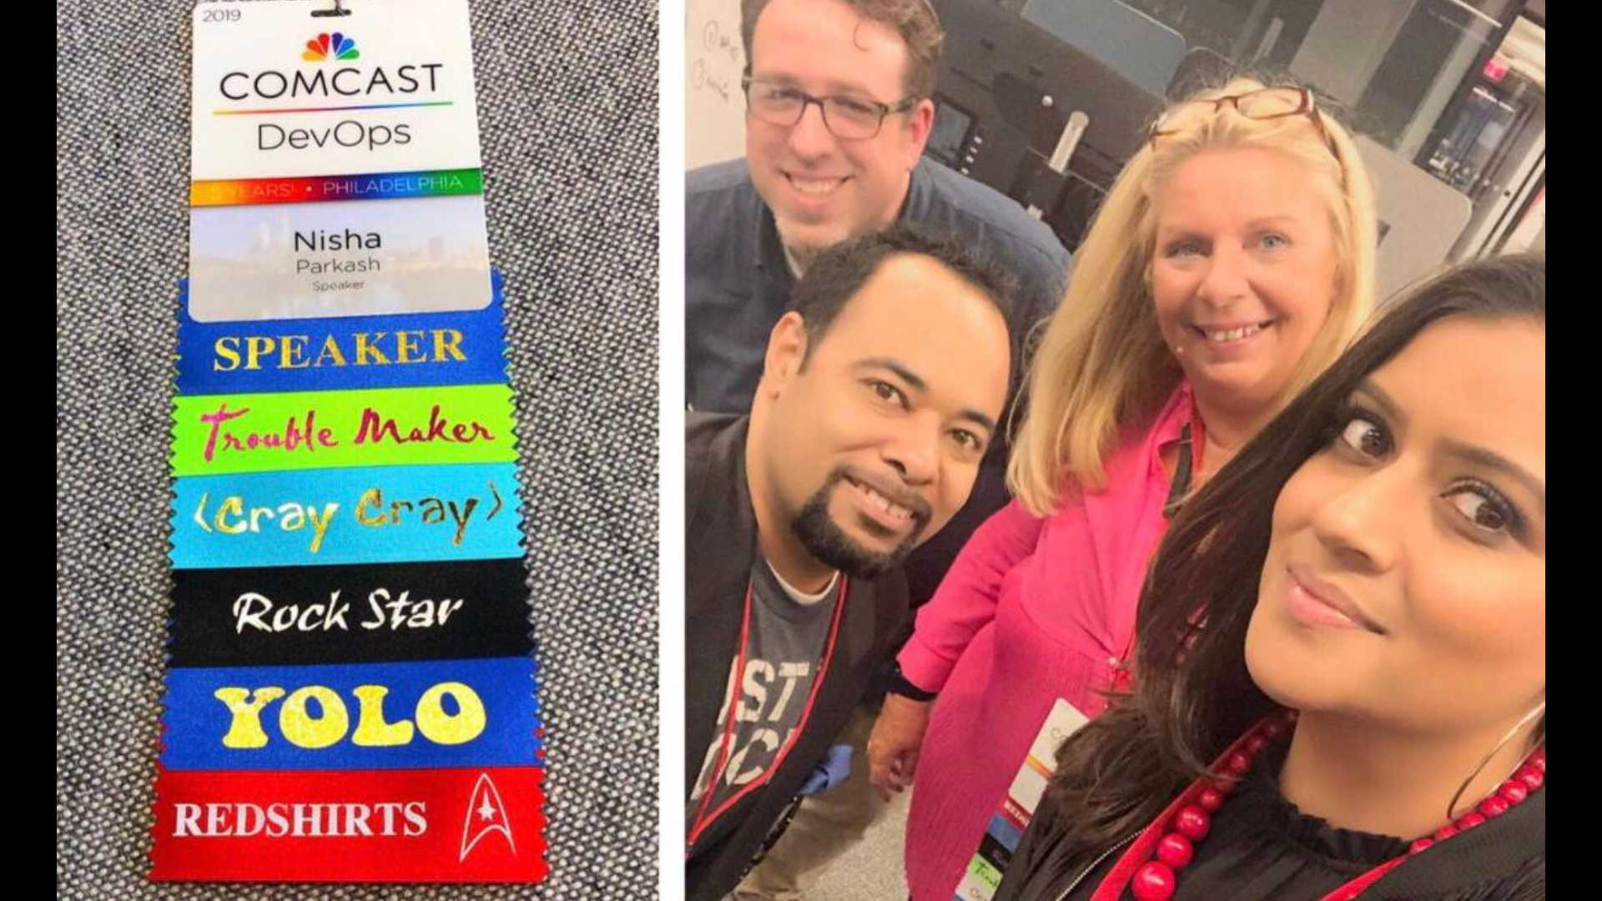
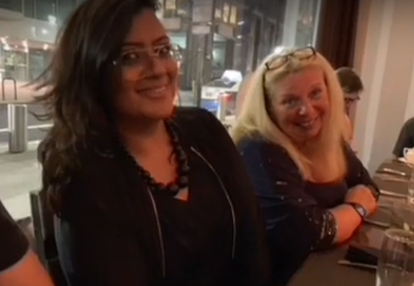
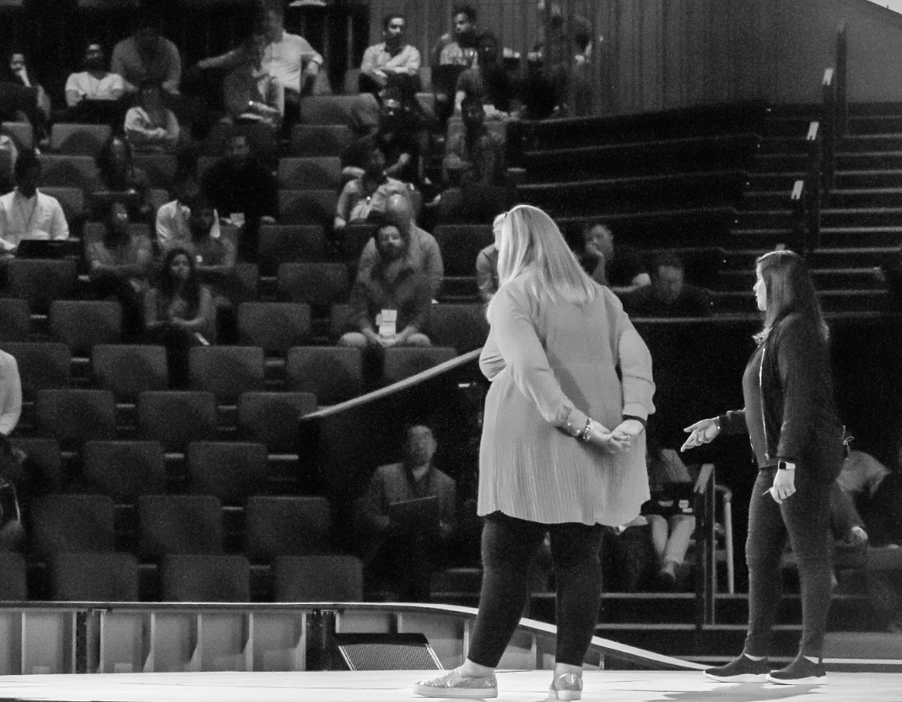
October 2019
@michaelswinslow

Slide 6
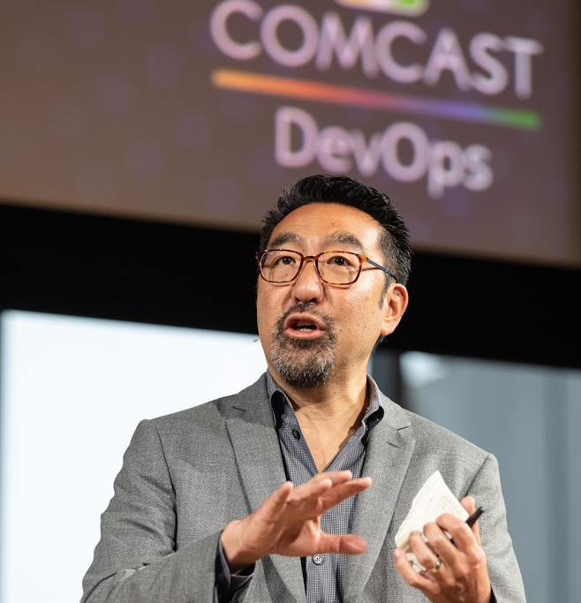
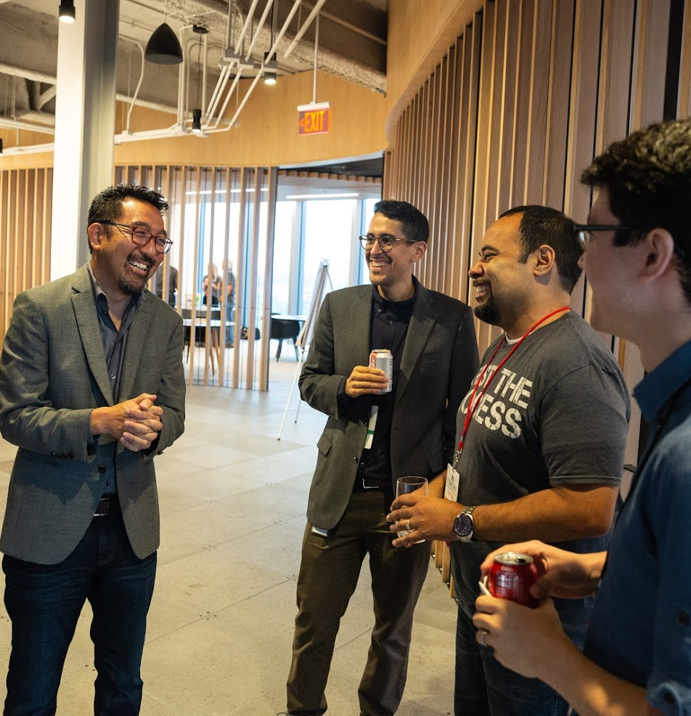
@michaelswinslow

Slide 7
The DevOps Conference was nice.
Now how do we work together on something?
VinylDNS @ SKY
@michaelswinslow

Slide 8

200k+ Zones | 40M+ DNS records
Enforces standards for all DNS entries
Fine-grained access controls to improve security
Robust API for integrations
(Why wouldn’t SKY want to take a look?)
@michaelswinslow

Slide 9

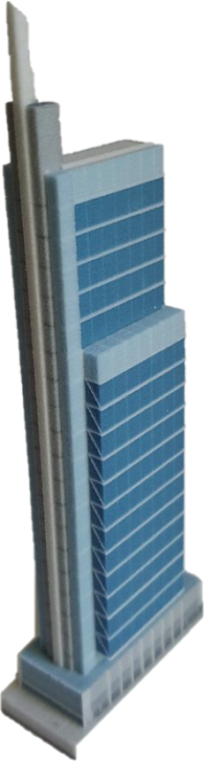








London, UK
Philadelphia, PA
@michaelswinslow
https://www.blackillustrations.com/

Slide 10



London, UK
@michaelswinslow
https://www.blackillustrations.com/

Slide 11
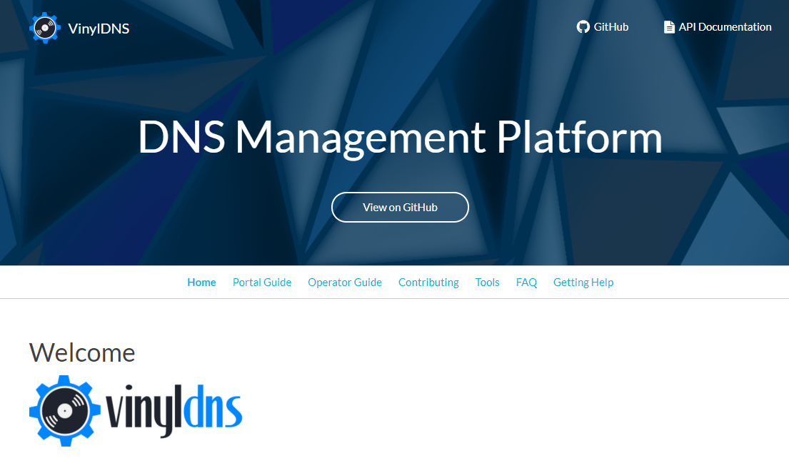
https://www.vinyldns.io/
@michaelswinslow

Slide 12
The Dojo
The Comcast Dojo is an “upskilling program” that is designed to be an immersive learning experience where full-stack teams come together to learn modern engineering, product, and agile practices.
@michaelswinslow

Slide 13
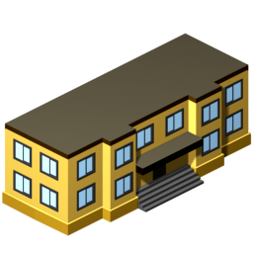

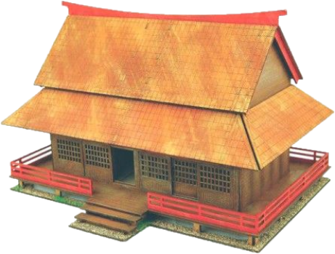
LEARN
WORK
LEARN + WORK
@michaelswinslow

Slide 14
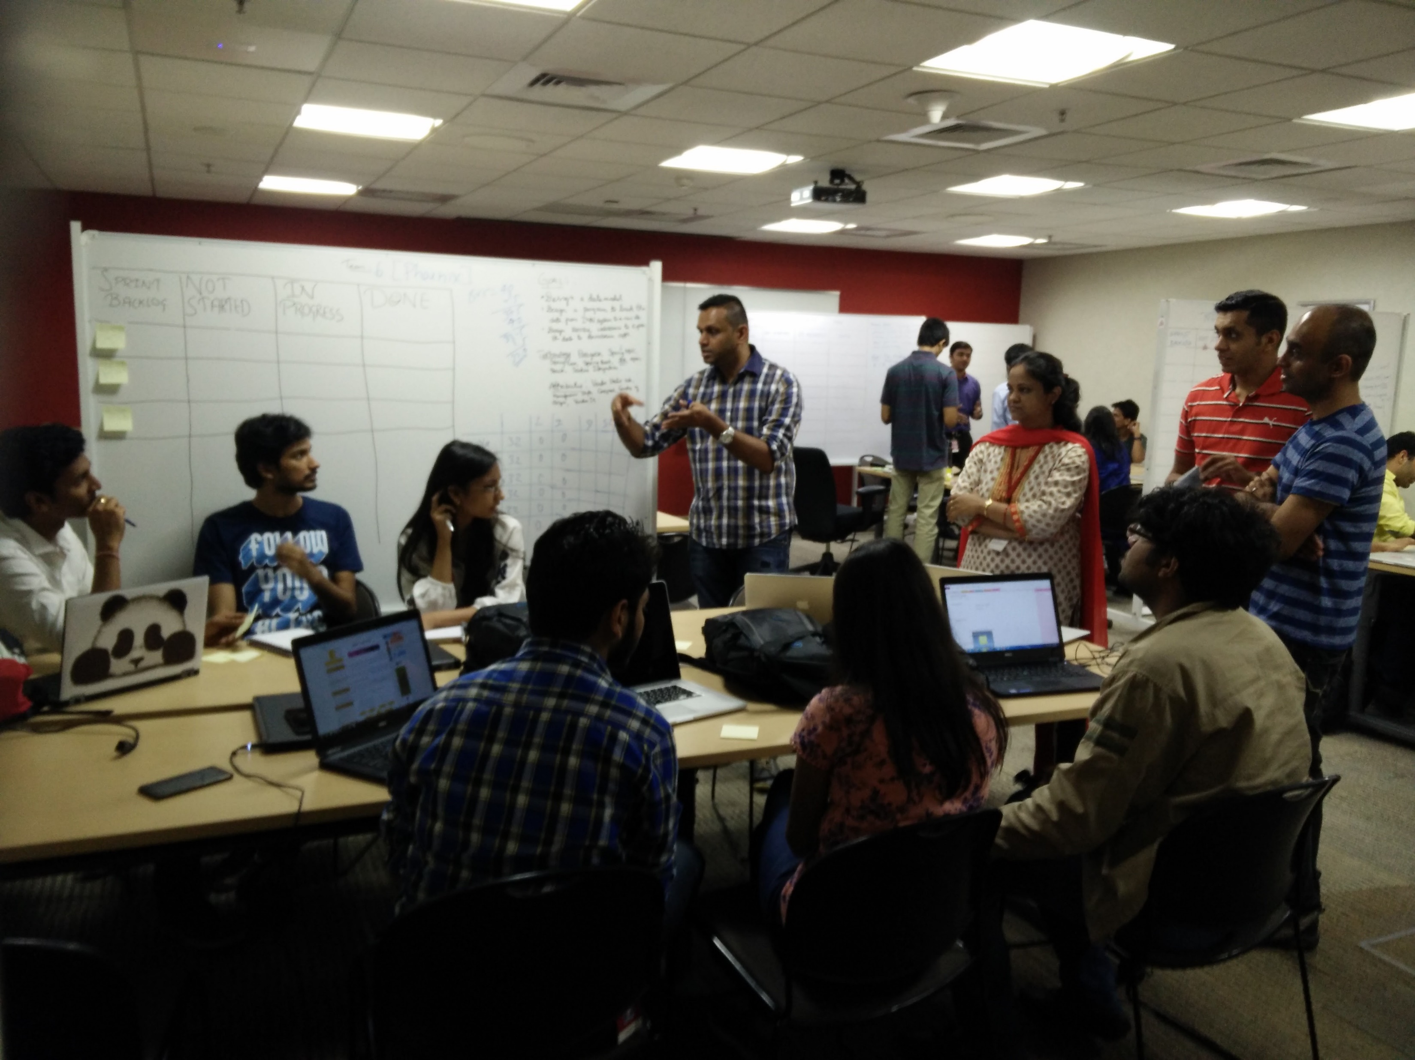

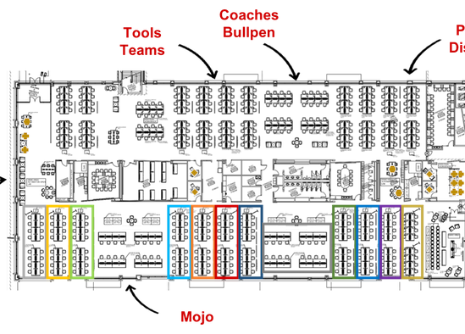
https://dojo.target.com/
@michaelswinslow

Slide 15

Ross Clanton
Jaclyn Damiano
Carmen DeArdo
John Esser
Eric Passmore
https://itrevolution.com/forum-paper-downloads/
@michaelswinslow

Slide 16
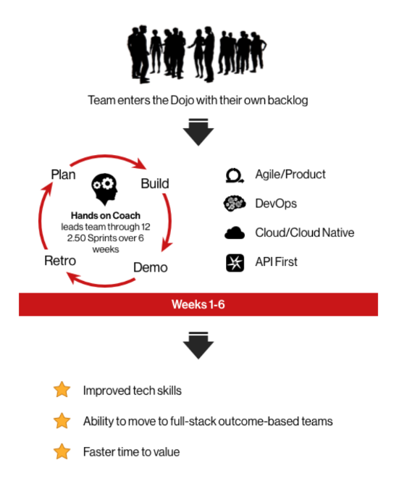
What is not a Dojo?
@michaelswinslow
https://github.com/devopsenterprise/2017-San-Francisco/blob/master/WEDNESDAY/

Slide 17
For POC,
1 or 2 day Sprints
What is not a Dojo?
@michaelswinslow
https://github.com/devopsenterprise/2017-San-Francisco/blob/master/WEDNESDAY/

Slide 18

We went in with a plan…
@michaelswinslow
https://www.blackillustrations.com/

Slide 19
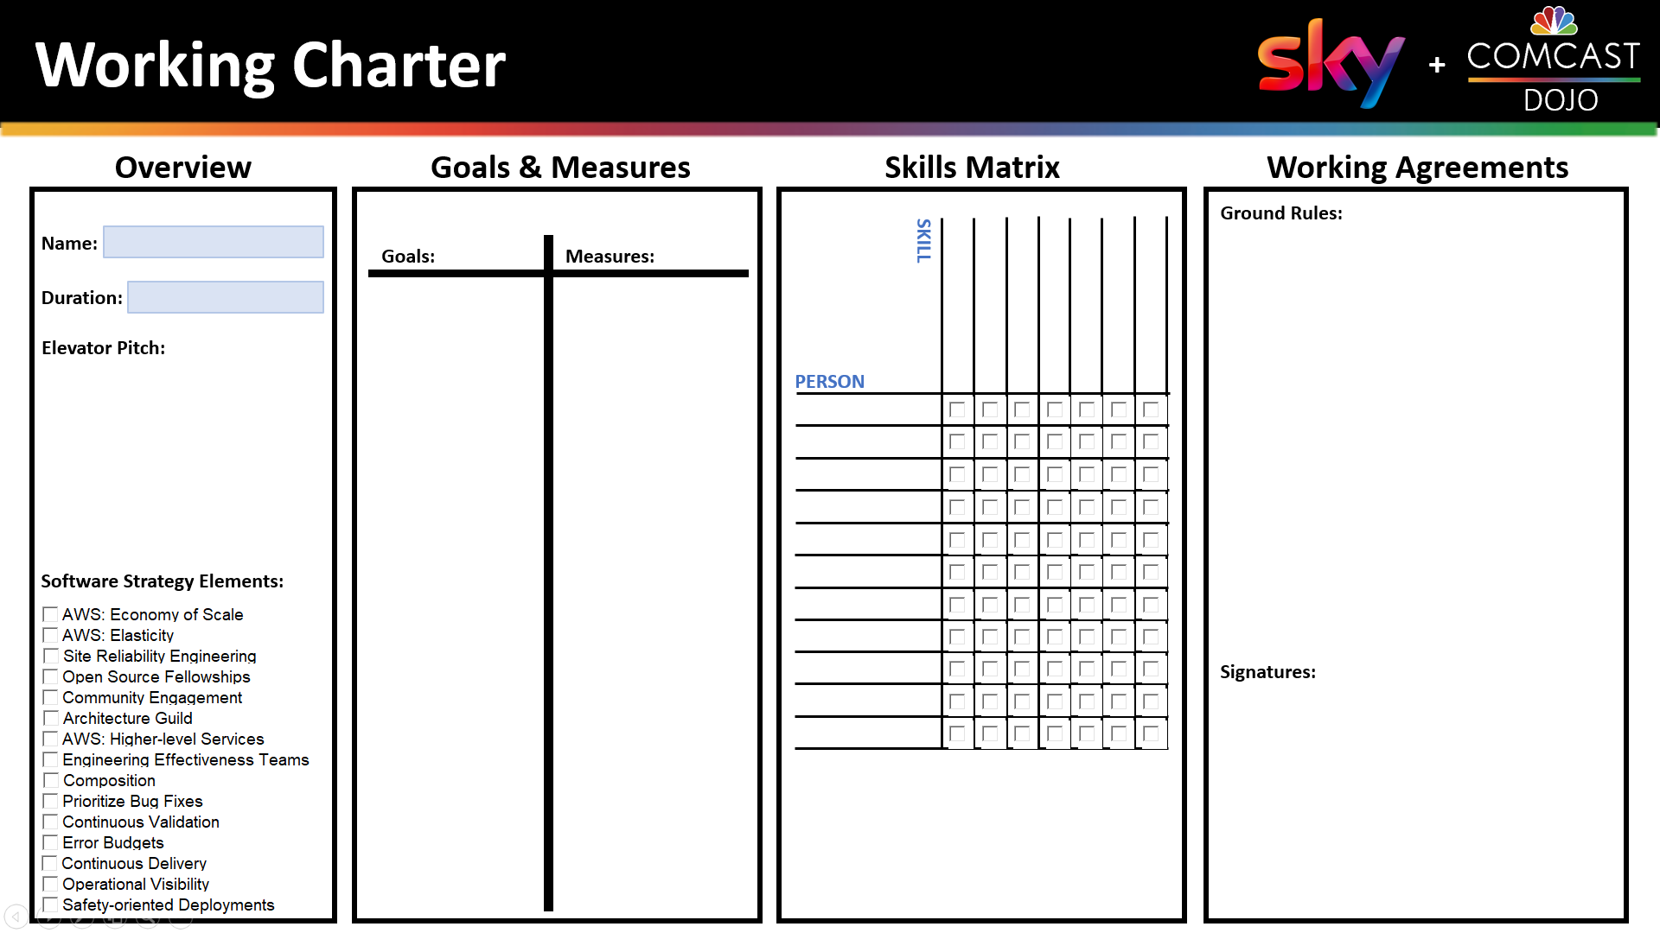

Working Charter

Slide 20
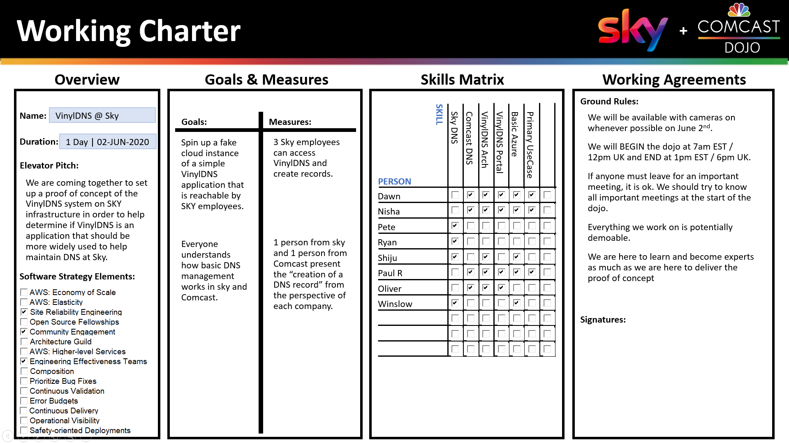
Working Charter

Slide 21
Working Charter

Slide 22
Working Charter

Slide 23
Working Charter

Slide 24
Working Charter

Slide 25
Working Charter

Slide 26
Working Charter

Slide 27
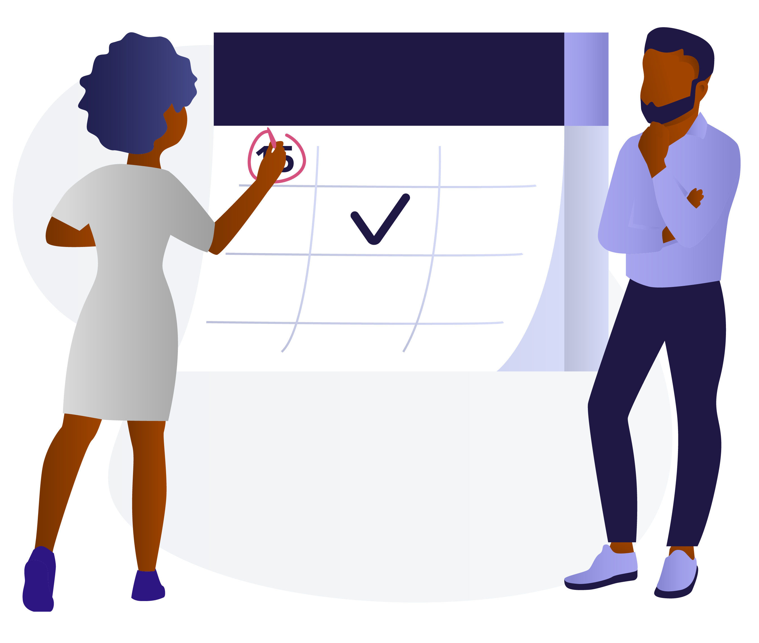
We were agile…
@michaelswinslow
https://www.blackillustrations.com/

Slide 28
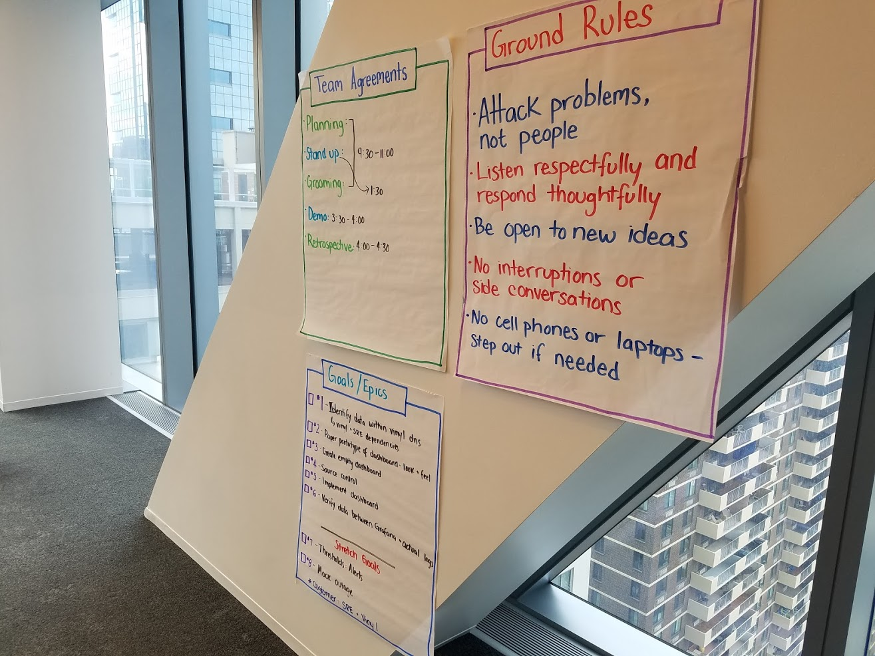
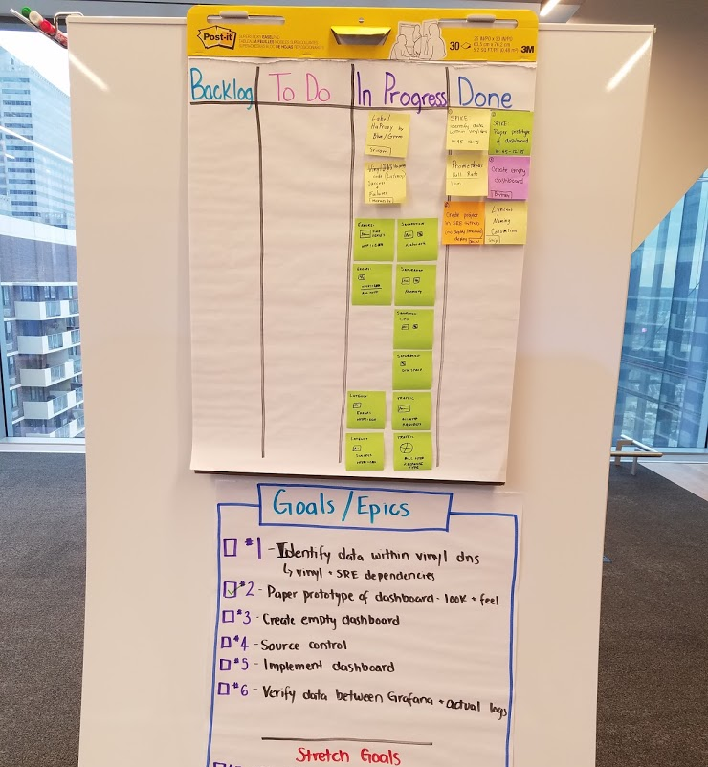
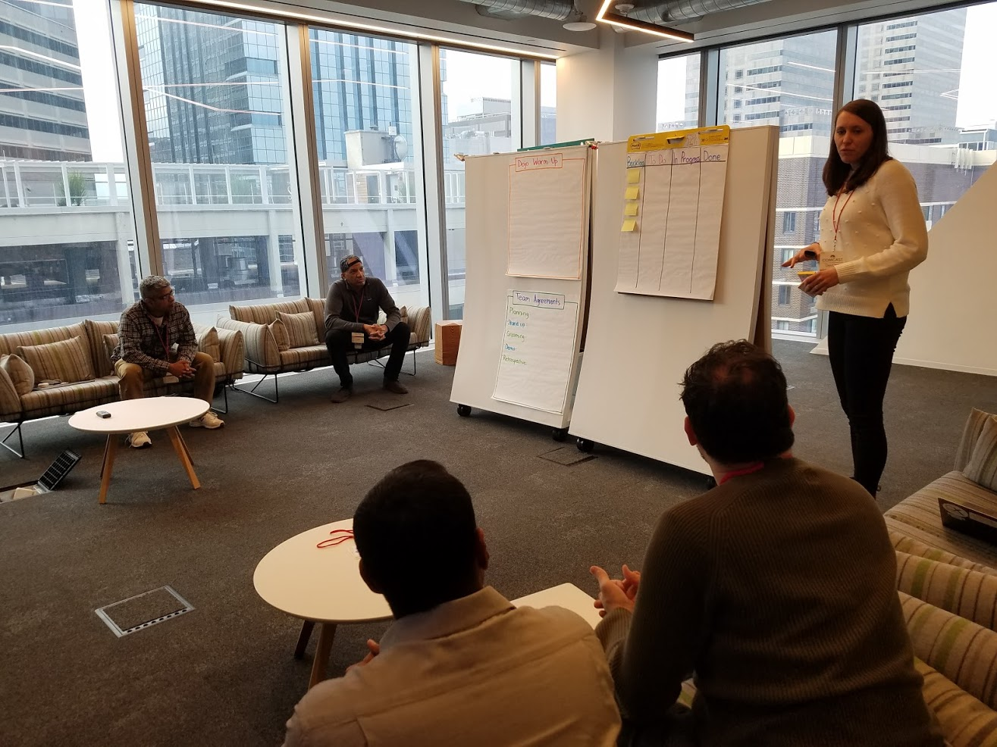
@michaelswinslow
January 2020

Slide 29
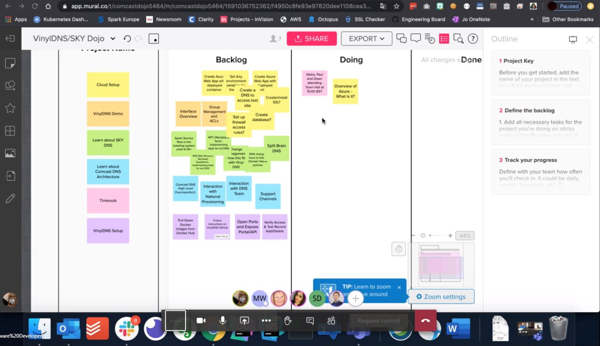
Day of – Working together
@michaelswinslow

Slide 30

We were product focused…
@michaelswinslow
https://www.blackillustrations.com/

Slide 31
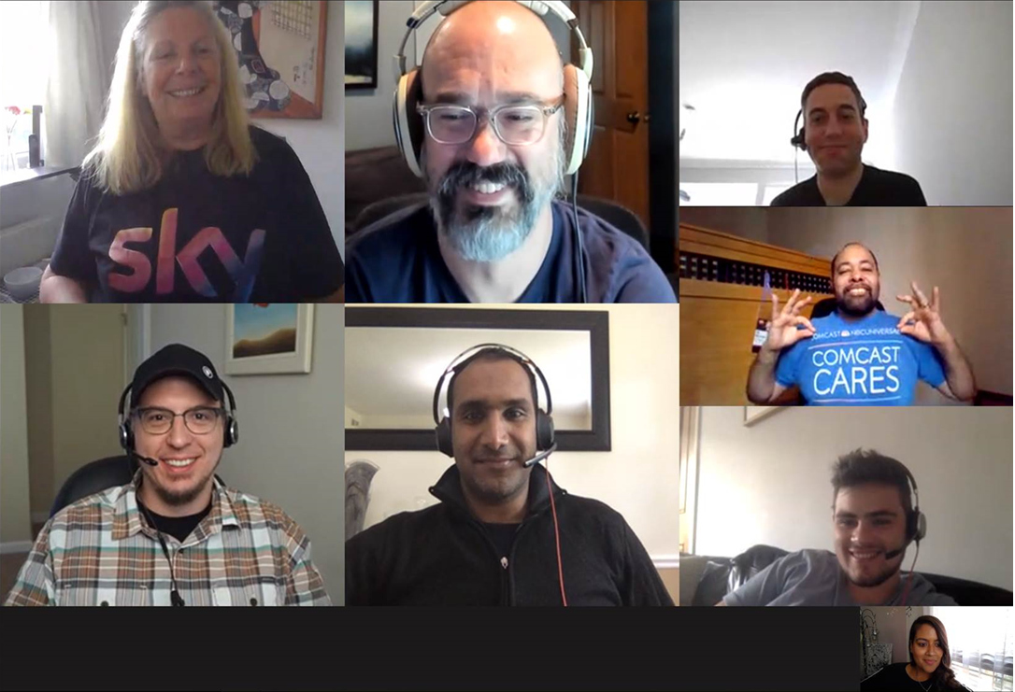
Paul:
Product
Manager
Dawn:
A couple more
classes and she’ll
understand what
REAL football is!
Pete:
He may be PC2 in your programs,
But he’s #1 in
Your hearts!
Winslow:
Wrong meeting, but
they let me stay!
Day of – Working together
Shiju
aka
“Tupperware”:
He’ll sell you on
CONTAINERS
RYAN:
I’m convinced he’s
A bot
Ollie:
He has the Konami
CHEAT CODE to the
SKY Infrastructure!
@michaelswinslow
Nisha: LIKE A BOSS!

Slide 32
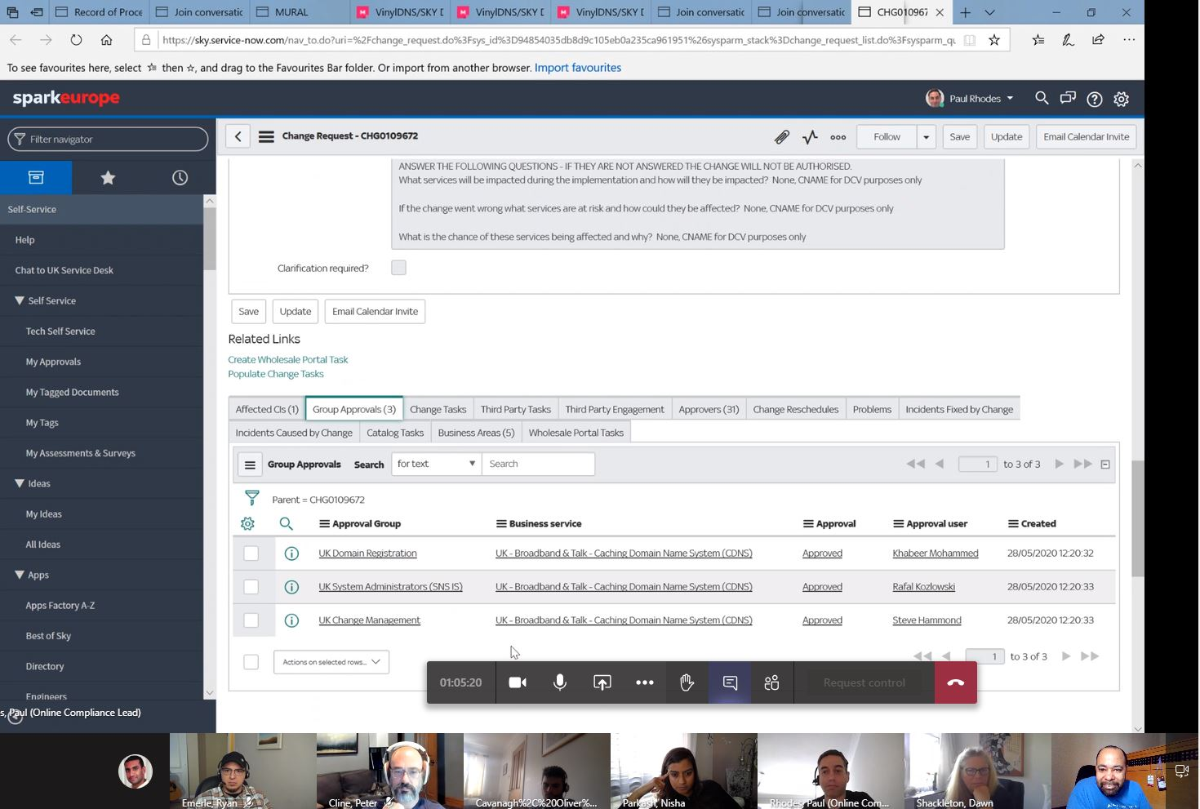
Day of – Working together
@michaelswinslow

Slide 33

Of course, we were Devops…
@michaelswinslow
https://www.blackillustrations.com/

Slide 34
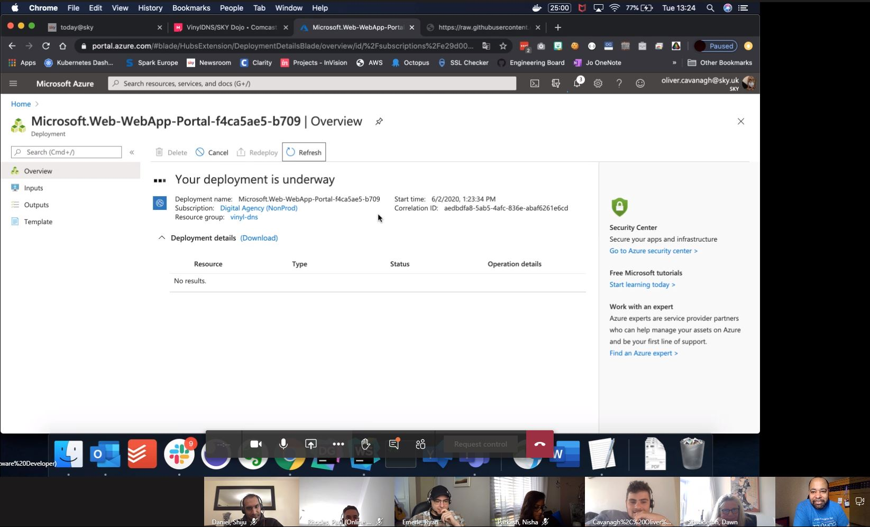
@michaelswinslow

Slide 35
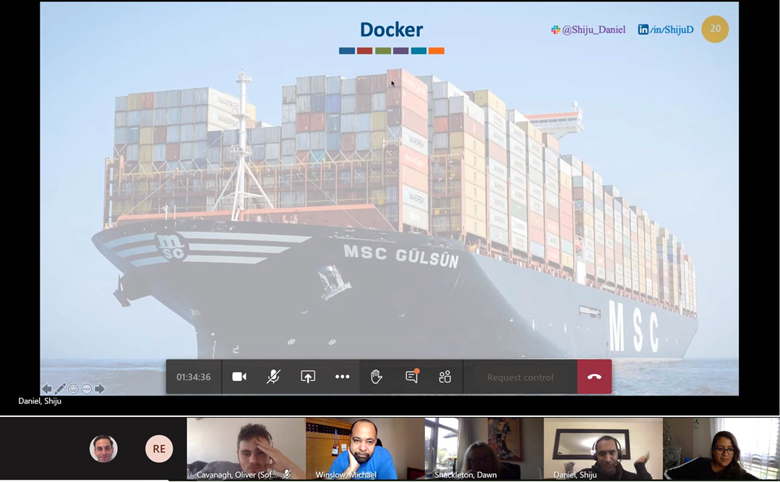
@michaelswinslow

Slide 36
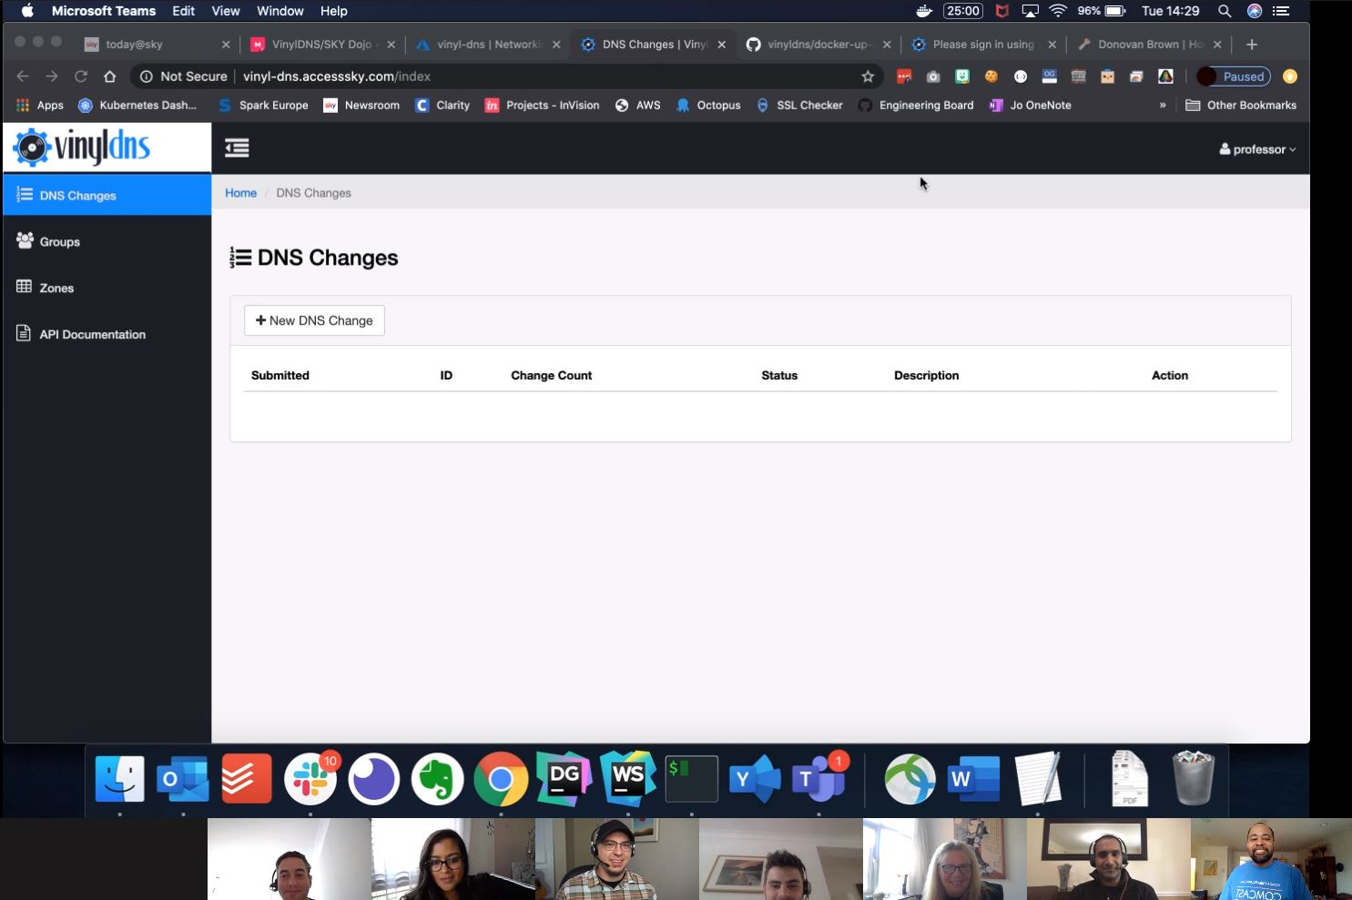
@michaelswinslow

Slide 37
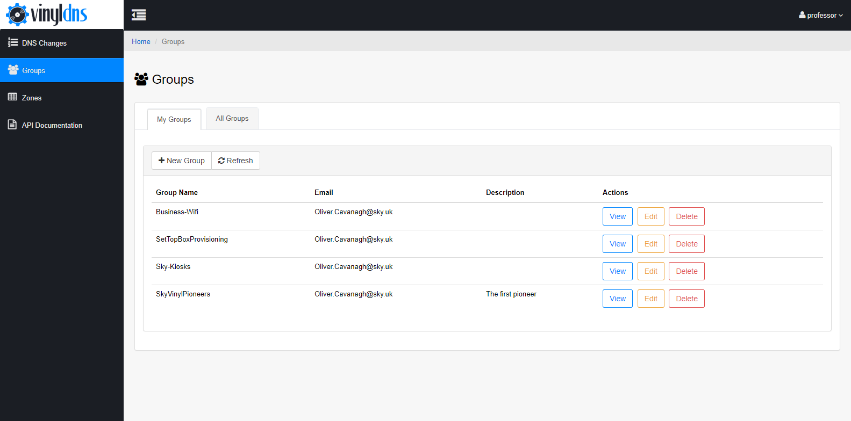
@michaelswinslow

Slide 38
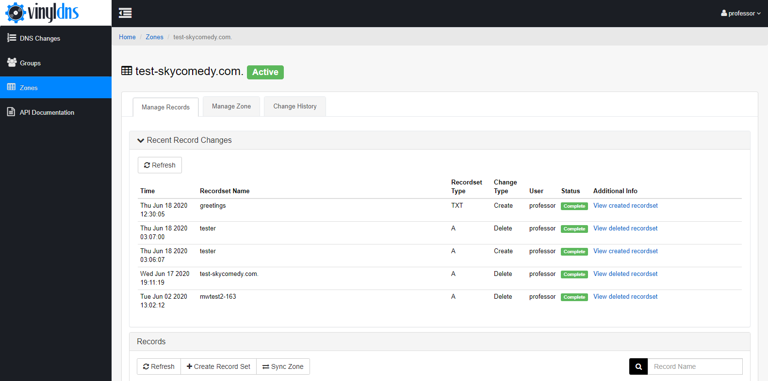
@michaelswinslow

Slide 39

Nisha – The Road Ahead
@michaelswinslow

Slide 40

How can you help?
https://www.vinyldns.io/
@michaelswinslow
https://www.blackillustrations.com/

Slide 41
Thank You!
Michael Winslow
Engineering Director
Comcast
Nisha Parkash
Online Compliance Manager
Sky
michaelswinslow
nishaparkash
@michaelswinslow

